Slide 1
One Gloucestershire
Integrated Care System
Ambitious for the future

Slide 2
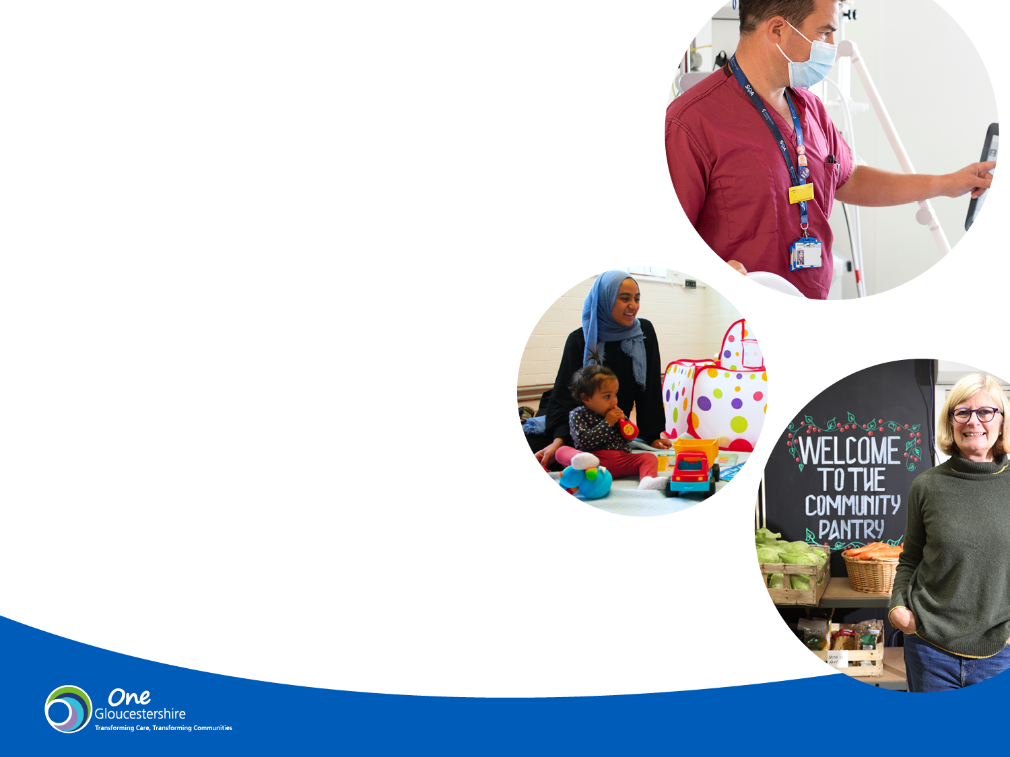
Purpose of this pack
From 1 July 2022, One Gloucestershire Integrated Care System (ICS) will become
a legal entity.
The ICS brings together the NHS, social care, public health and other public, voluntary and community sector organisations.
We know that by working together we can better respond to the challenges facing us today, but also improve health outcomes
and address health inequalities over the longer-term.
The purpose of this pack is to outline our emerging priorities for Gloucestershire whilst describing the changes that are taking place.

Slide 3

Our vision for health and care
- and key priorities
1

Slide 4
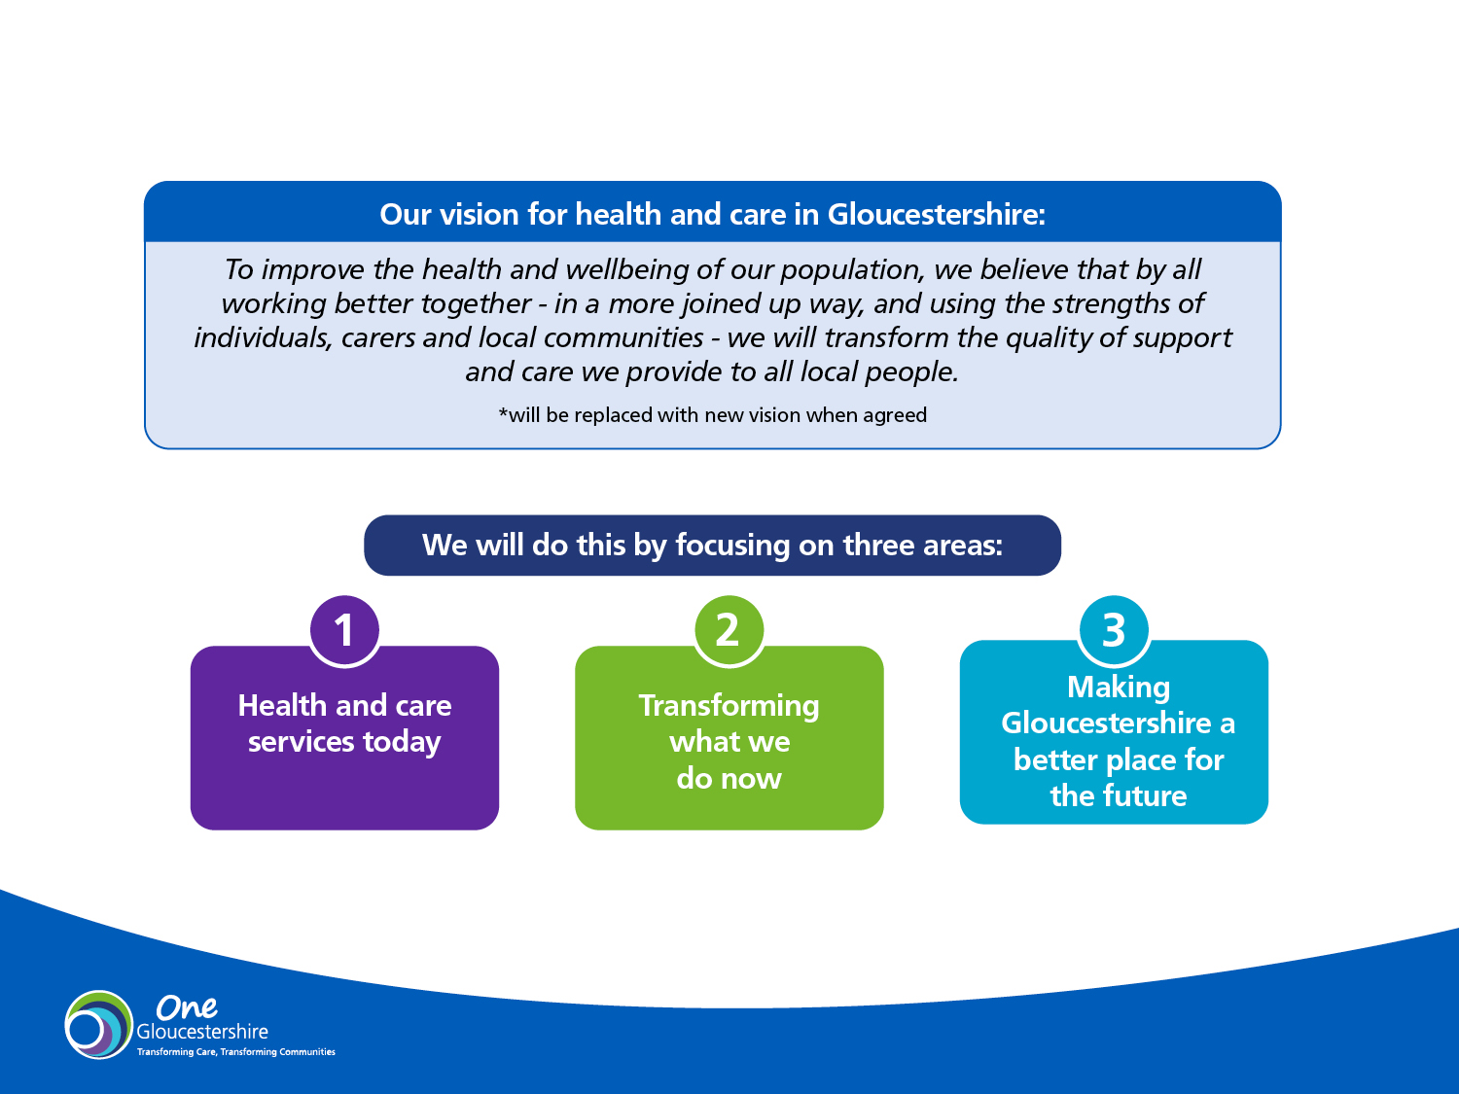
Our vision for health and care in Gloucestershire
Our vision for health and care in Gloucestershire:
To improve the health and wellbeing of our population, we believe that by all working better together - in a more joined up way, and using the strengths of individuals, carers and local communities - we will transform the quality of support and care we provide to all local people.
*will be replaced with new vision when agreed
We will do this by focusing on three areas:
Improving health and care services today
Transforming what we do now
Making Gloucestershire a better place for the future

Slide 5
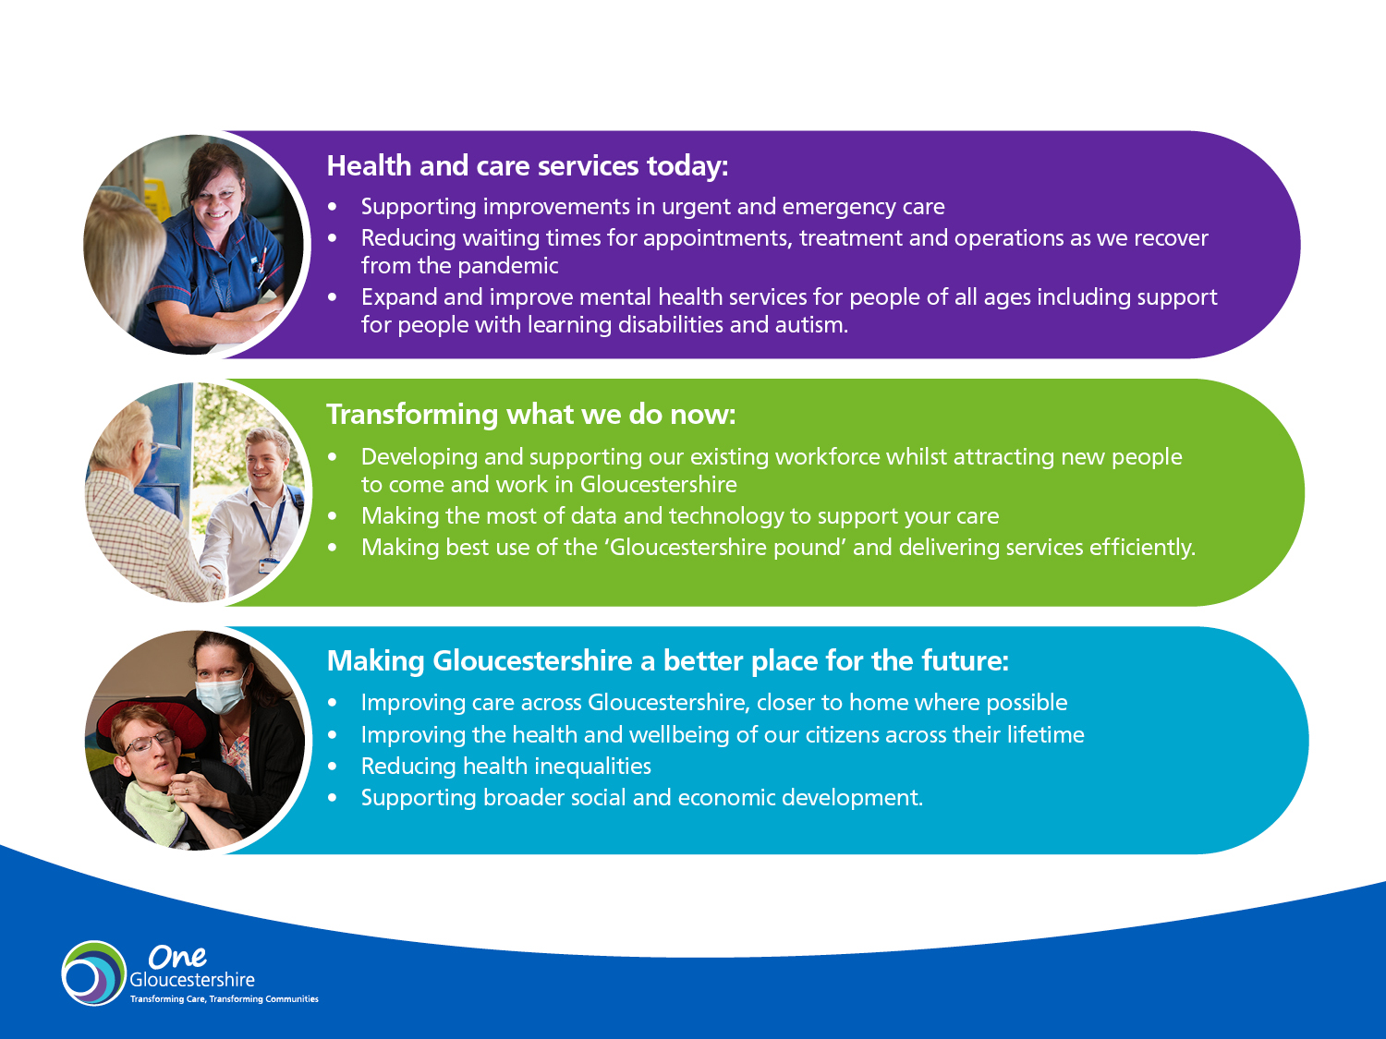
Our priorities
Our priorities
Improving health and care services today
Supporting improvements in urgent and emergency care
Reducing waiting times for appointments, treatments and operations as we recover from the pandemic
Expand and improve mental health services for people of all ages including support for people with learning disabilities and autism
Transforming what we do now
Developing and supporting our existing workforce whilst attracting new people to come and work in Gloucestershire
Making the most of data and technology to support your care
Making best use of the ‘Gloucestershire pound’ and delivering services efficiently.
Making Gloucestershire a better place for the future
  Improving care across Gloucestershire, closer to home where possible
  Improving the health and wellbeing of our citizens across their lifetime
  Reducing health inequalities
  Supporting broader social and economic development

Slide 6

What is changing
from July 2022
and how we will
make decisions
2

Slide 7
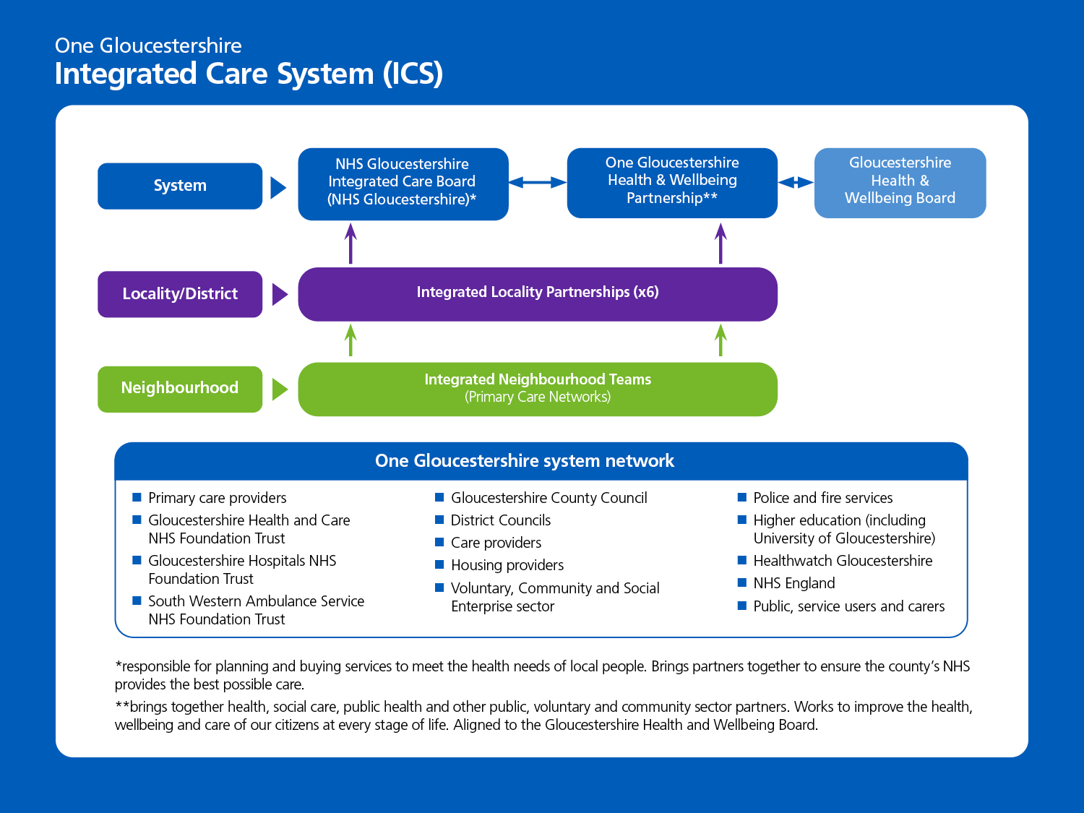
How we will make decisions

Slide 8
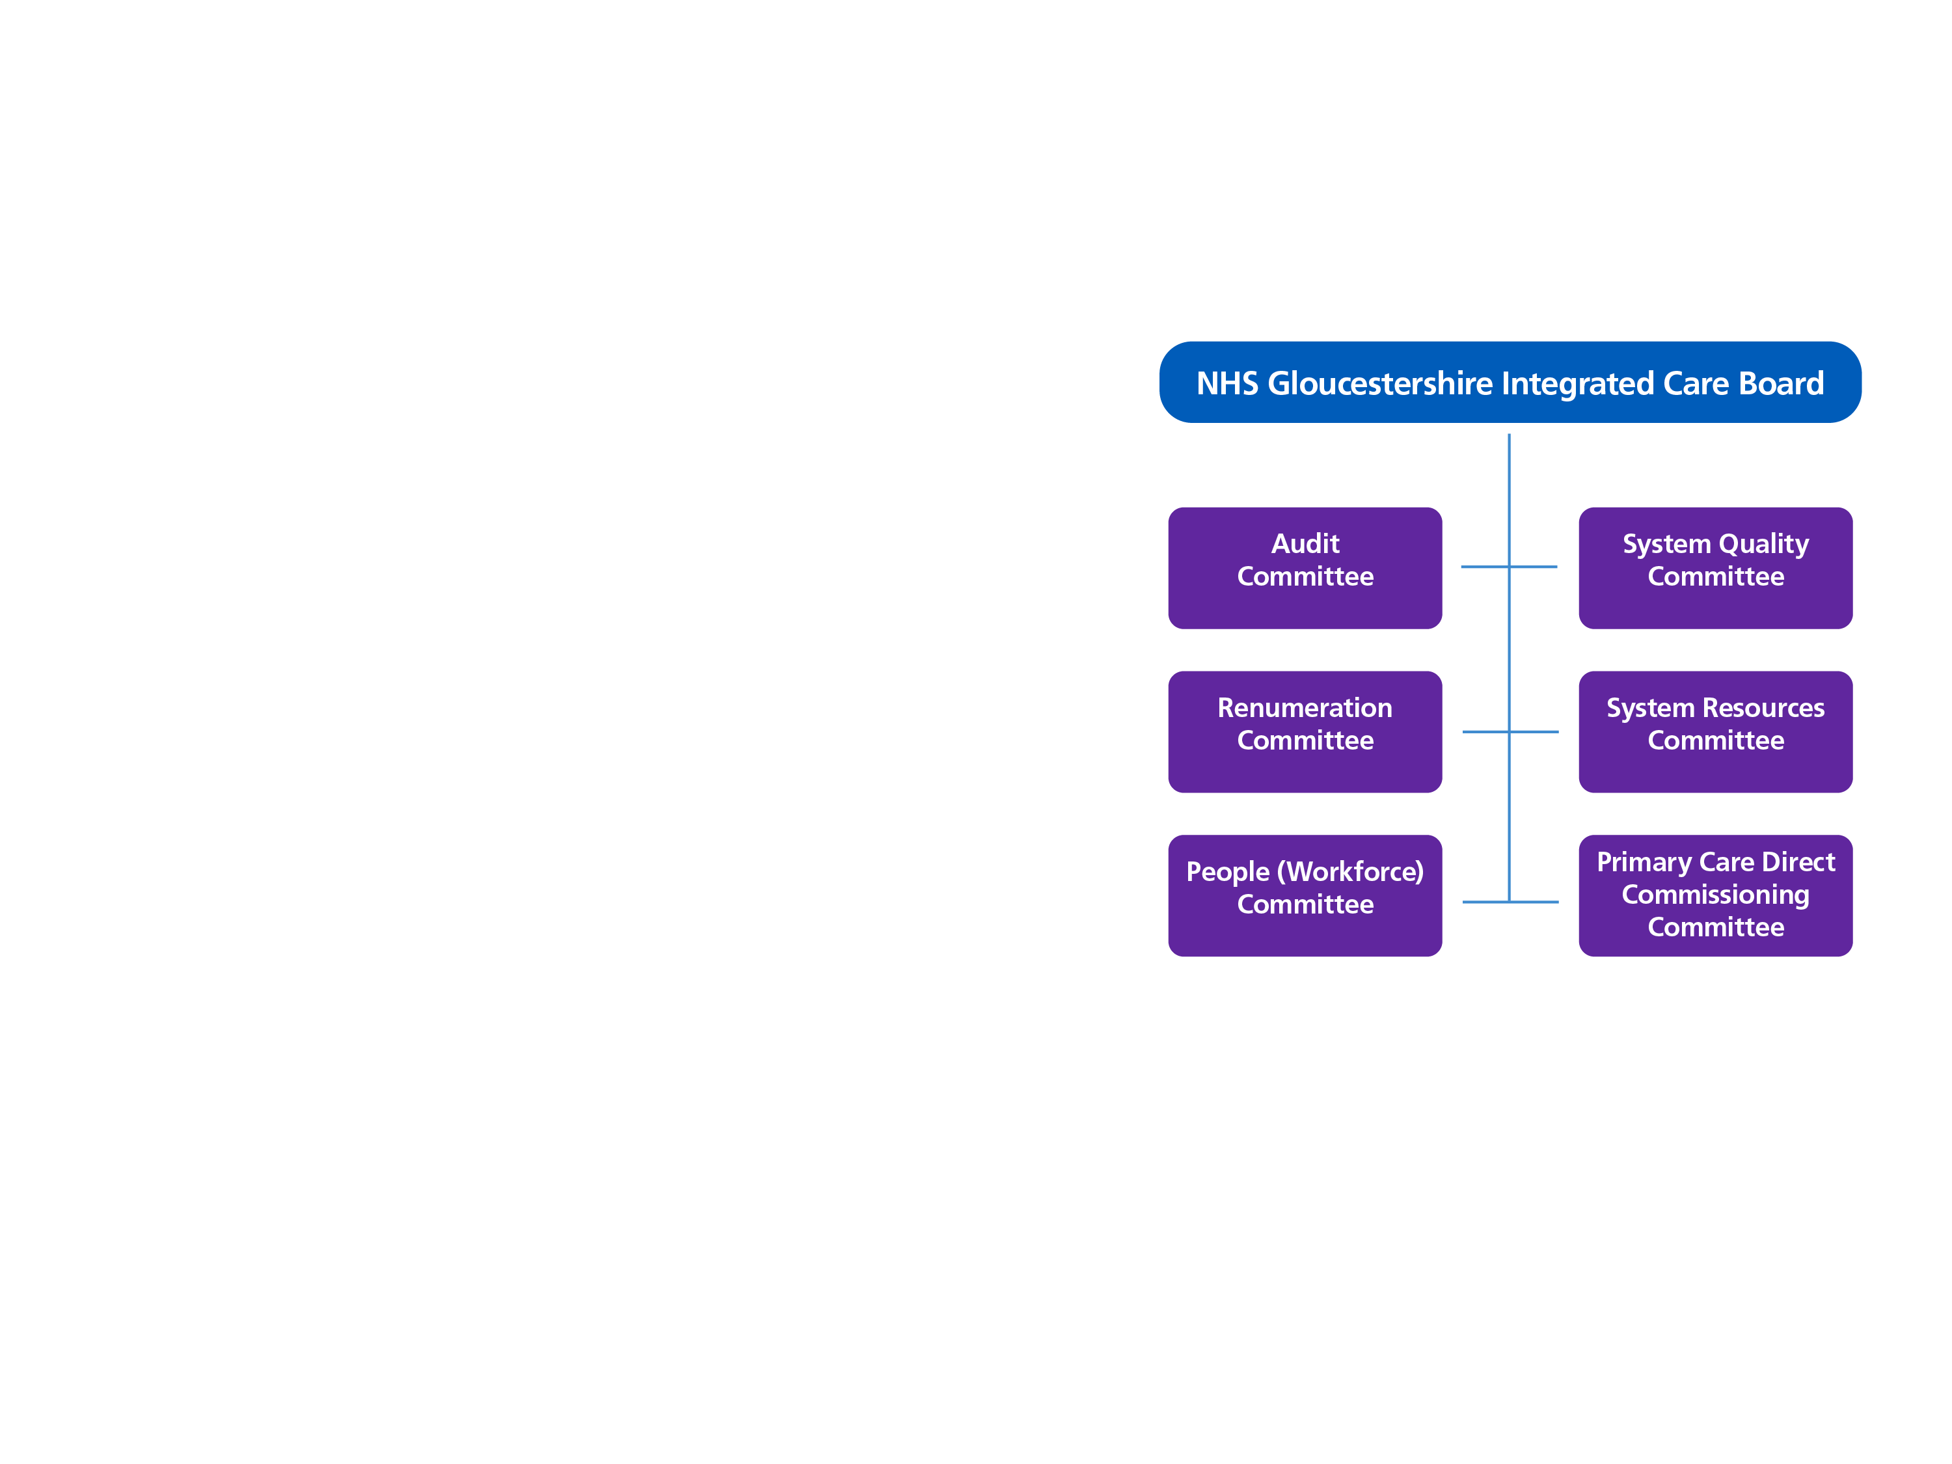
NHS Gloucestershire Integrated Care Board (ICB)
NHS Gloucestershire Integrated Care Board (NHS Gloucestershire) will be responsible for deciding how NHS money is spent.
The ICB will also be responsible for developing a plan to meet the healthcare needs of local people.
The ICB will be made up of a formal Board and Committee structure.
The Board will bring together Executive and Non-Executive Directors as well as partner members from local NHS organisations (NHS Trusts and Primary Care) as well as the Local Authority.

Slide 9
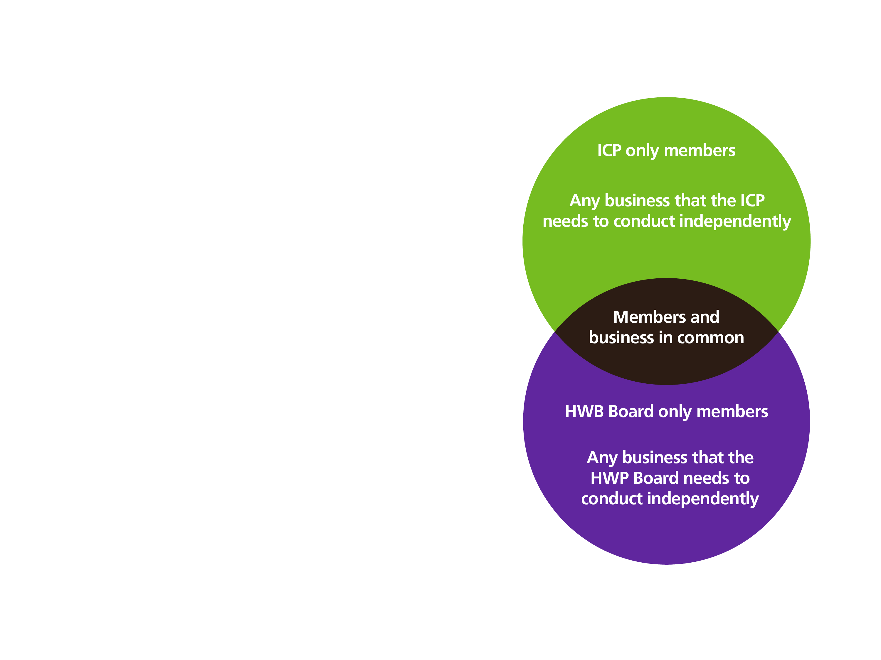
One Gloucestershire Health and Wellbeing Partnership
How the Integrated Care Partnership will be aligned to the existing Health and Wellbeing Board
One Gloucestershire Health and Wellbeing
Partnership is the name given to our Integrated
Care Partnership (ICP).
The ICP will be aligned with Gloucestershire’s
existing Health and Wellbeing Board, with a
shared chair and some members in common.
It will be made up of representatives from health,
social care, public health and other public voluntary and community sector partners.
The partnership will be responsible for agreeing
an integrated care strategy for improving health
and wellbeing in Gloucestershire.

Slide 10

How we will
work together to
achieve better
health and care
3

Slide 11

How we will work together…
The changes taking place from July 2022
are more than just a structural change.
They give us an opportunity to decide
together what is important for Gloucestershire
and to work more collaboratively to deliver
this change.
These new ways of working will evolve
and together we will seek to work
more closely:
  As partners
  With people and communities
  With the One Gloucestershire
  workforce

Slide 12
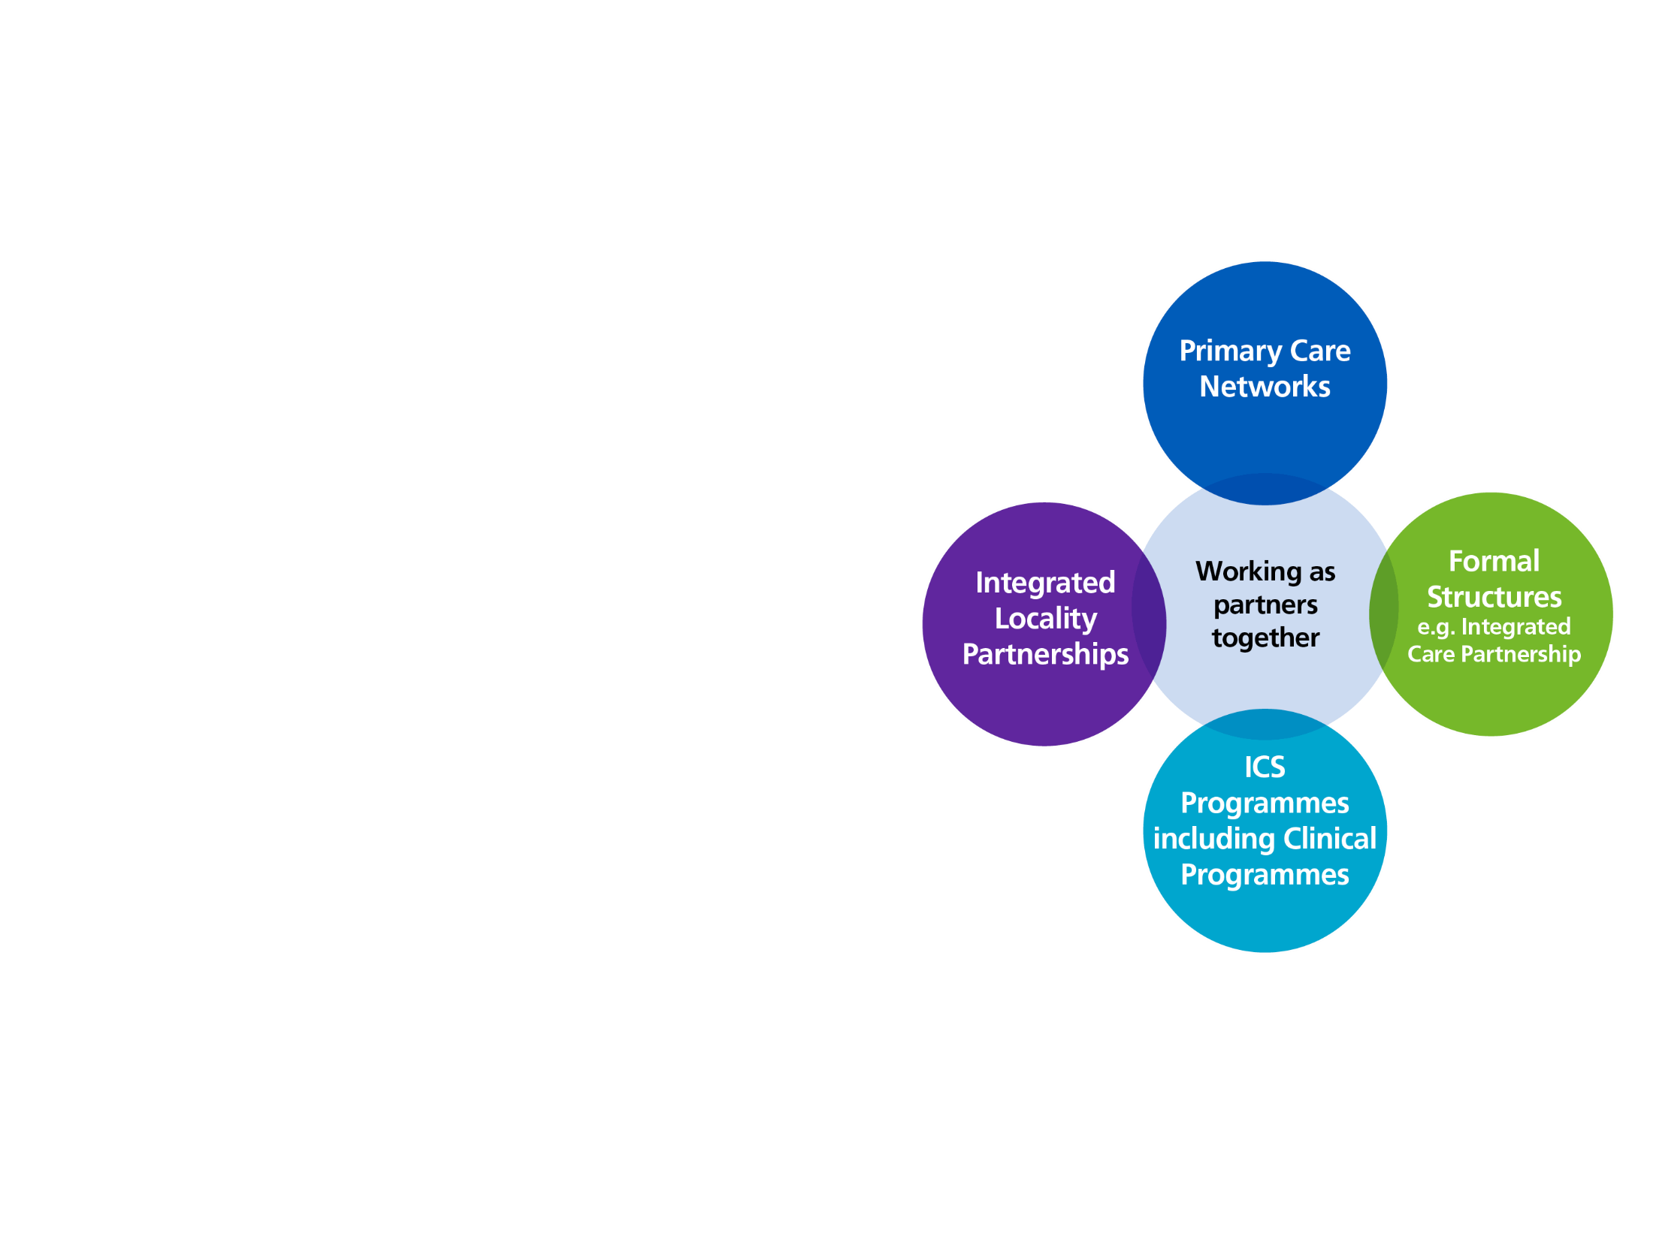
a) Working as partners
We are committed to working together with partners to deliver our collective ambitions for health and care in Gloucestershire. Partners will continue to be involved in:
Supporting the delivery of care closer to home through Primary Care Networks (soon to be known as Integrated Neighbourhood Teams)
Improving population health through district
level Integrated Locality Partnerships in Gloucestershire
Redesigning the way health and care is provided through ICS transformation programmes
Where appropriate engaging through formal board structures such as the Integrated Care Partnership.

Slide 13
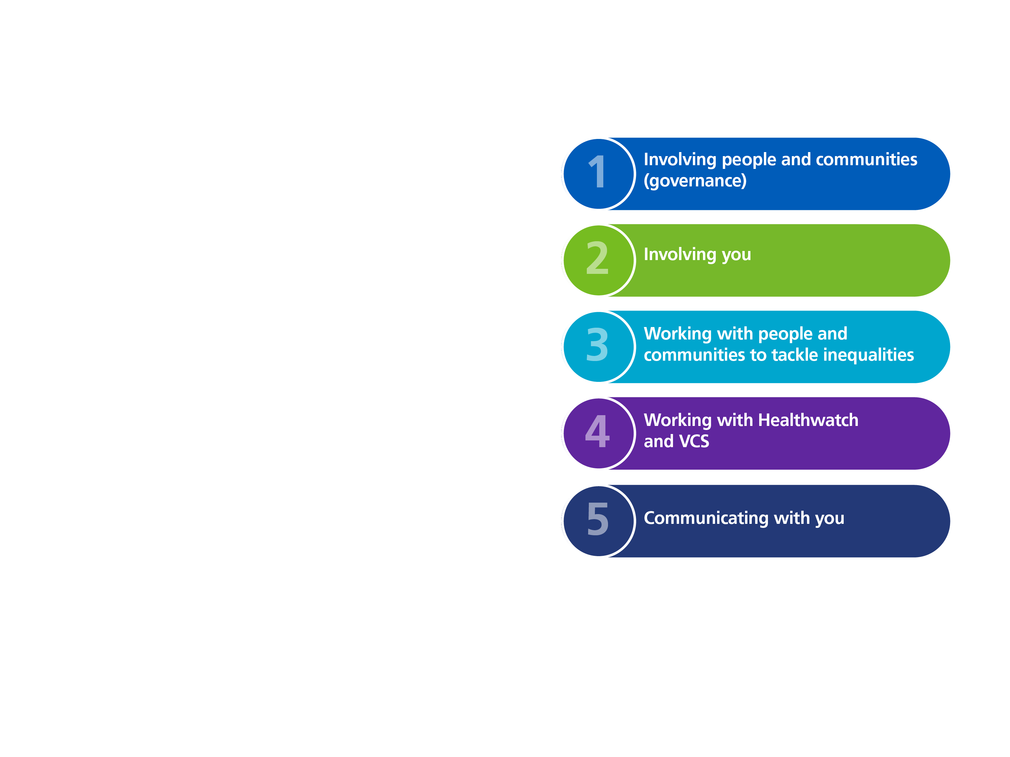
b) Working with people and communities
We have adopted a strategy for working with people and communities based around 5 key areas
As partners we will seek innovative and new ways to engage with people and communities
This includes:
  The development of a Gloucestershire Citizens’ Panel
  Learning from people’s stories of using health and care services
  Developing an Insight HUB (an online space/library) where all reported feedback from local people and communities can be kept together in one place, to assist decision makers and avoid duplication/involvement fatigue.

Slide 14
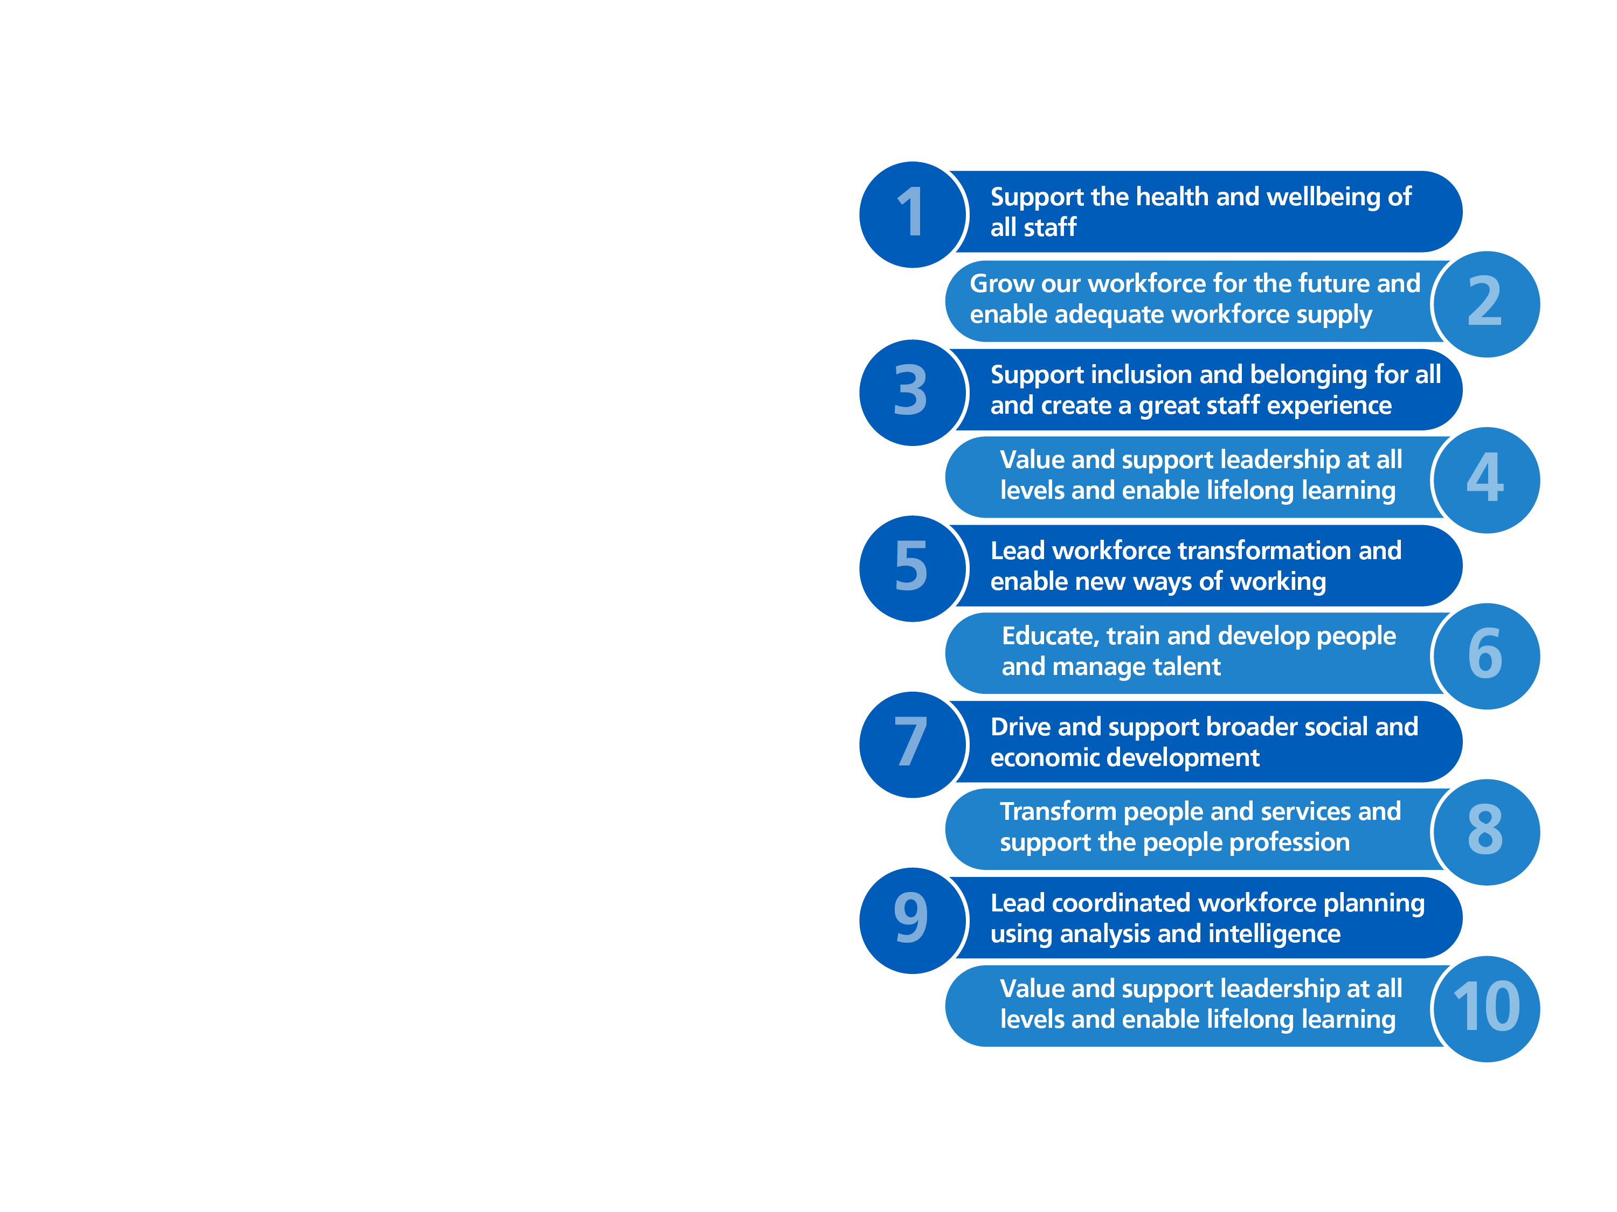
c) Developing the One Gloucestershire workforce
Our commitment is to create ‘One Workforce for One Gloucestershire’
with the values, behaviours, skills and opportunities to deliver high quality care
By working as health and care partners we will together deliver the 10 priority areas
We will support collaboration across teams, ensure the voices of the workforce are heard and that we excel in engagement.

Slide 15
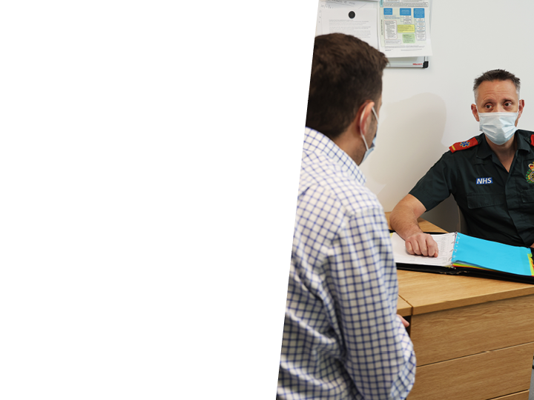
Where you can
find out more
4

Slide 16

How you can find out more…
More information is available on the
One Gloucestershire ICS portal:
onegloucestershire.net
The One Gloucestershire Health and
Wellbeing Partnership pages will be
available from 1 July through the
One Gloucestershire ICS portal:
onegloucestershire.net
The NHS Gloucestershire website will
also be available via the portal or by visiting:
nhsglos.nhs.uk

