Slide 1
Policy, Power and Psychological Wellbeing: A Feminist Mixed-Methods Exploration of Unpaid Carers' Interactions with UK State Institutions
Cathy Dean, MSc Health Psychology
cathydean@connect.glos.ac.uk

Slide 2
Content
Background
Philosophy
Methodology
Challenges
Call to Action
Why this topic?
MSc Findings

Slide 3
Why This Topic?
My personal circumstances
Importance of Social Justice
Findings from my MSC

Slide 4
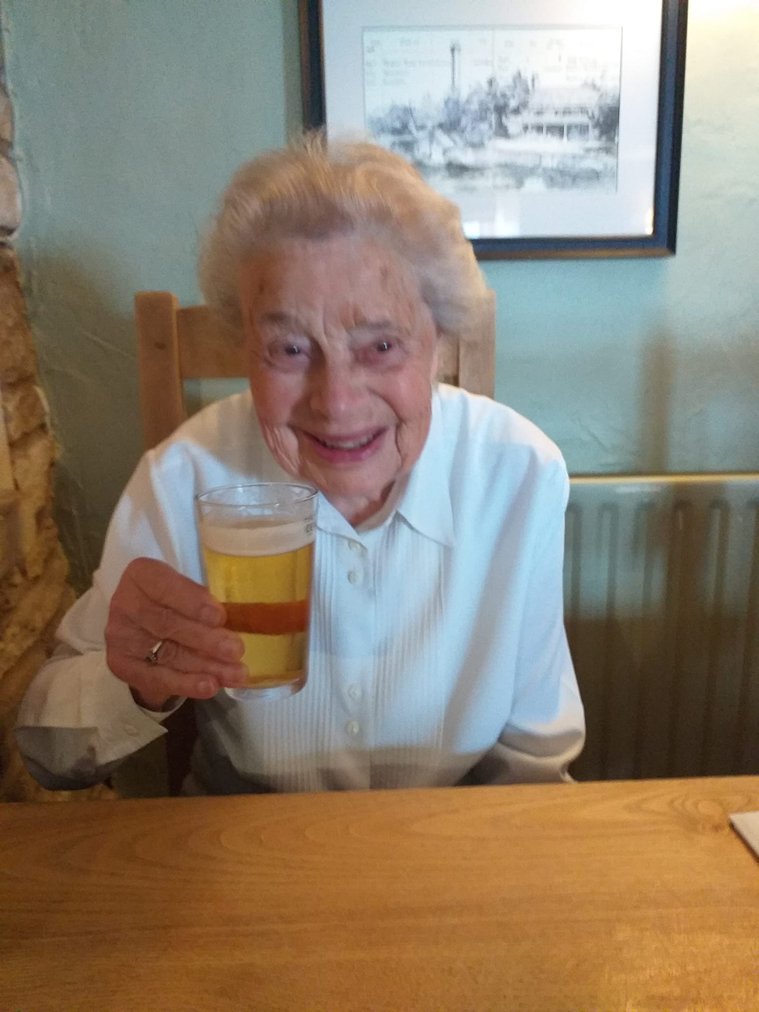
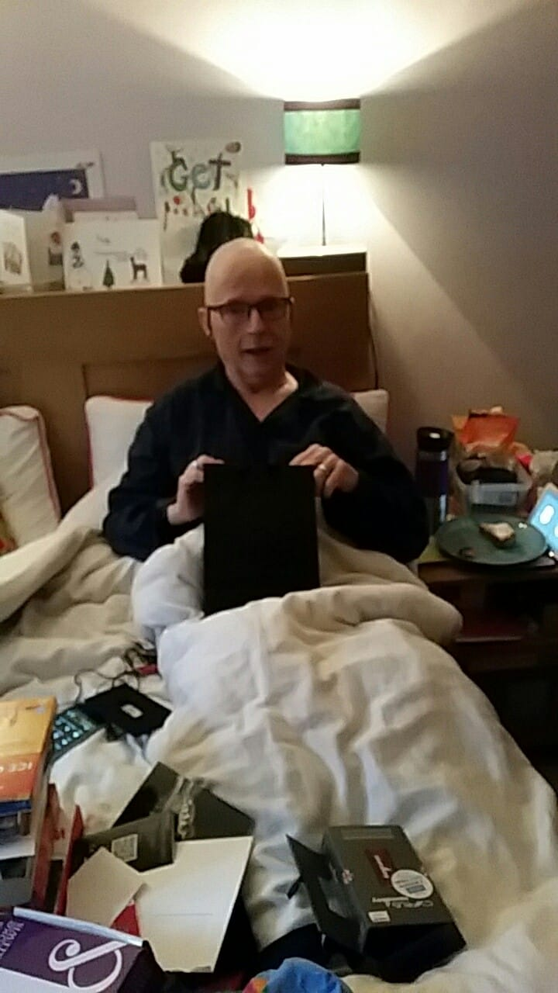

Why This Topic?

Slide 5
MSc Health Psychology
The unspoken reasons why unpaid carers in the UK do not seek support for their own wellbeing​
Unpaid carers provide unpaid care or support for a friend, relative or neighbour who, due to illness, disability, a mental health problem or addiction, cannot cope without physical, mental or emotional support.
(Carers Trust, 2024; Becqué et al., 2021; Francis & Hanna, 2022)

Slide 6
MSc Health Psychology
There are currently between 5.7 and 10.6 million carers in the UK, and 4.7 million people across England and Wales are providing more than 20 hours per week of care (Carers UK, 2023).

Slide 7
MSc Health Psychology
The negative impact of caregiving
Depression | Anxiety
Resentment | Loneliness
Loss of sleep | Guilt
Relationship difficulties | Financial stress

Slide 8
MSc Health Psychology
Stated reasons for not seeking professional help
Lack of time | Lack of money
Not needed | Not right for me
But what's really going on?

Slide 9
MSc Health Psychology
Traumatic Experiences of Caring
arise from
the expectations carers set for themselves to be invincible and bear the burden of caring without help and support for their own needs;
the combination of adverse psychological and emotional experiences caused by the reality of being a carer;
the institutional violence inflicted on carers by a system that seeks to deny, delay and divert resources from those that need them most.

Slide 10
MSc Health Psychology
Elements of Trauma
Dehumanisation as a result of impersonal, objective systems and processes
Diminishment of social status and autonomy by the system
Institutional violence through systemic neglect via delay, denial and diversion

Slide 11
MSc Health Psychology
Elements of Trauma
Daily marginalisation, discrimination and microaggressions leading to chronic ongoing stress
Feeling endangered
Loss of previous identity and home
Being gaslighted
Disempowerment

Slide 12
The PhD
Policy, Power and Psychological Wellbeing: A Feminist Mixed-Methods Exploration of Unpaid Carers' Interactions with UK State Institutions

Slide 13
Rationale
For over 30 years, research has consistently shown that, while there can be positive benefits for both carer and cared-for person (Larkin et al., 2019; Taylor & Quesnel-Vallée, 2017), generally speaking, unpaid caregiving negatively impacts carers' wellbeing (Stephanou, 2023).
The term "caregiver burden" describes this negative effect, encompassing both psychological and structural difficulties (Liu et al., 2020).
Structural burden, a key component of caregiver burden, arises from carers' interactions with formal systems (Taylor & Quesnel-Vallée, 2017).
This study aims to examine structural burden and its impact on aspects of caregiver wellbeing.

Slide 14
Philosophy and Methodology
Transformative Feminist Paradigm
Participatory Action Research
collection, analysis, and interpretation of knowledge from within the participant community
to improve relevance and impact of research
bringing about social justice and social equality from the grassroots upwards
mixed-methods cyclical design-based methodologies
intersectional approach
focusing on social justice
addressing power imbalances
promoting social change
community members equal partners in research

Slide 15
Phase One – Mixed Methods Systematic Review
Research Objective
To synthesise existing evidence to understand the psychological wellbeing of carers in relation to their interactions with state institutions such as the Department for Work and Pensions (DWP) and the Department for Health and Social Care (DHSC).
Research Questions:
What is the association between unpaid carers psychological wellbeing and their interactions with state institutions’ systems and processes?
How do unpaid carers experience and perceive their interactions with state institutions’ systems and processes in the context of their caring role?

Slide 16
Phase Two – Mixed Methods Systematic Review
Research Objective
To produce a holistic understanding of the institutional systems and processes that are the most salient contributary factors in the structural burden of unpaid carers.
Research Questions
Which systems and processes are most strongly associated with perceived systemic burden among unpaid carers, and what factors account for the variation in these associations?
How do unpaid carers experience and make sense of their interactions with systems and processes that contribute most to systemic burden?

Slide 17
Challenges
Ethical issues (my own): lack of funding making it impossible to provide financial remuneration to co-researchers when
NIHR best practice calls for financial remuneration
Participants prefer financial remuneration
Does replacing co-researchers with an advisory committee of current and former carers still centre the voice of the community?
Approaches to reflecting on my insider status as a carer

Slide 18
Call to Action
Take a trauma-informed approach to working with carers​ - don't expect them to be proactive
​
Advocate for systemic reform to better meet need carers' needs
Give me your thoughts on the ethics around alternative forms of recognition
Remember that one day, if it hasn't already happened, you are likely to either be or need an unpaid carer. What do you want that experience to be like?

Slide 19
Questions?

